Slide 1
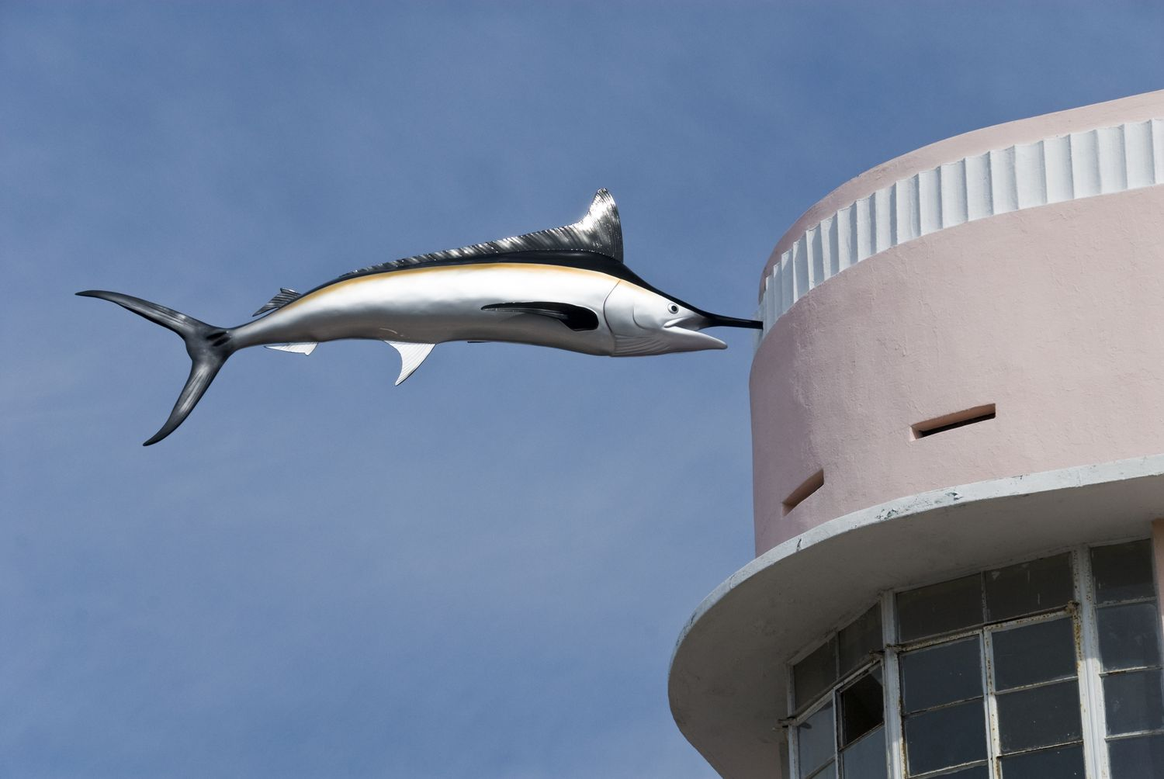
Idea building and Developing the Throughline
EL5132

Slide 2
Developing a topic for pitching to an audience
What was the last thing you were really excited by or intrigued by?
What are two or three things you are most proud of?
When was the last time you were in conversation with someone who said, “That’s really interesting”?
Have you observed anything that surprised/intrigued you?
What is one idea you’d most love to share with others?

Slide 3
Coming up with your idea and topic
Which aspect of the subject would you like to explore?
Phenomenon with scientific explanation Everyday or pertinent intriguing questions with scientific explanation
Elucidating a theory/finding/research/question in any of the above aspects
How things work
Latest STEM or medical discovery or potential and how it works
Problem, solutions and call to action, with scientific explanations
Which subject are you interested in?
Biology
Physics
Chemistry
Engineering
Mathematics
Medicine and Health
Technology and Invention
Computer Science e.g. AI and Machine Learning
Neuroscience, Cognitive Science, Psychology, Behavioural Economics

Slide 4
The Throughline
Connecting theme or plot in a story/movie
E.g. ‘Love does not conquer all’
Line of argument in an essay
E.g. ‘Far from uniting the world, globalisation has divided us due to mankind’s self-interest, greed and xenophobia.’ Use PEEL.
Every talk should have a throughline because all the pieces in the talk must connect clearly.
A throughline keeps one focused on the key, necessary information.

Slide 5
The Throughline: Be very clear!
Compare the following start of a talk. Which has a clearer throughline? Why?
a) “I want to share with you some experiences I had during my recent trip to Cape Town, and then make a few observations about life on the road…”
OR
b) “On my recent trip to Cape Town, I learnt something new about strangers—when you can trust them and when you definitely can’t. Let me share with two different experiences I had.”
B is has a clearer throughline because it is more specific in depicting what the talk is about (trusting strangers)

Slide 6
The Throughline
Encapsulate your throughline in no more than 15 words. The throughline can be adapted to become the title for your talk.
Avoid a throughline that is too predictable or banal (e.g. ‘Why AI is awesome’)
Consider who are your audience and what they care about
Examples of throughline from actual TED Talks:
More choices actually make us unhappy
With body language, you can fake it till you become it
A history of the universe shows a path from chaos to order
Terrible city flags can reveal surprising design secrets
The combination of three simple technologies creates mind-blowing sixth sense
Online videos can humanise the classroom and revolutionise education

Slide 7
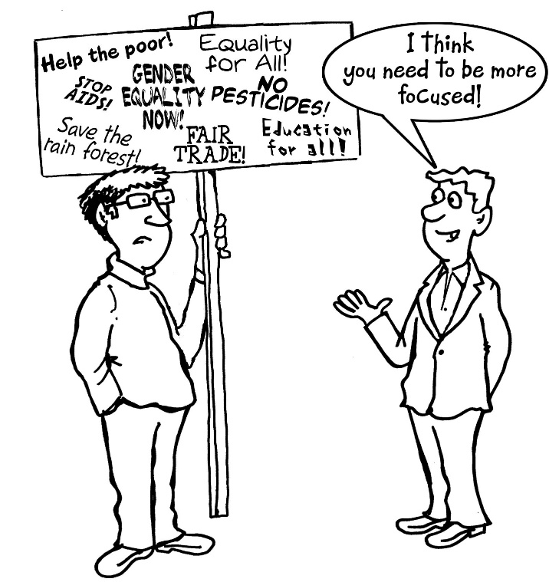
The Throughline
Activity 1 (Optional)
Write a 1-minute speech about yourself. The speech should encapsulate a clear throughline.

Slide 8
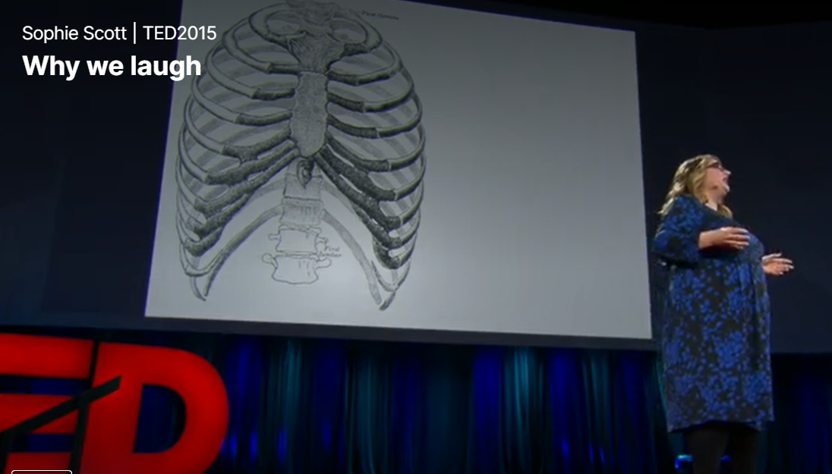
The Throughline
Activity 2
Watch the following talk and address the following questions.
What is the topic and the throughline?
What is interesting about the topic, idea and throughline?
What do you like about the talk?
https://www.ted.com/talks/sophie_scott_why_we_laugh?language=en

Slide 9
Activity 2
1) Topic: Laughter
Throughline: Why we laugh and the neurobiology of laughing (Vocalisations of and response to different types of laughter)
2) Topic is something everyone can relate to.
Interesting angle and insight into what seems to be a common topic.
3) +Personal anecdotes and stories
+ Illustrations through audio (laughter)
+ Interesting scientific studies on how brain responds to different types of laughter
+ Use of humour
+Good visuals (Slides consist visuals that accompany verbal explanation)
+ Clear explanation

Slide 10
Developing your idea and throughline
Checklist
Is this a topic I am passionate about?
Does it inspire curiosity?
Will it make a difference to the audience to have this knowledge?
Can I truly explain the topic within the time limit, complete with necessary examples?
What are the 15 words that encapsulate my talk?
Would those 15 words persuade someone to be interested in hearing my talk?

Slide 11
From Throughline to Structure
Common structure:
Introduction—Hook in the form of story, personal anecdote, thought-provoking questions
Context—Why this topic/issue matters
Main concepts and Examples
OR
Premise and Proof
Practical Implications / Call to action / Demonstration
Conclusion
Nevertheless, the structure is dependent on the topic. Any chosen structure should powerfully develop your throughline, and how each idea relates to it

Slide 12

Connectives in Speech (pg 21)
Notes:
Like writing, connectives in speech show the relationship between two sentences. In speaking, it has to be done even more deliberately and consciously, since the listener are not able to refer and re-read the previous sentence to process the relationship. Connectives are words or phrases that join the thoughts of a speech together and indicate the relationship between them. When a speaker uses connectives properly the speech will flow smoothly and make complex ideas understandable. Each speech should contain the following four connectives: transitions, internal previews, internal summaries, and signposts.

Slide 13
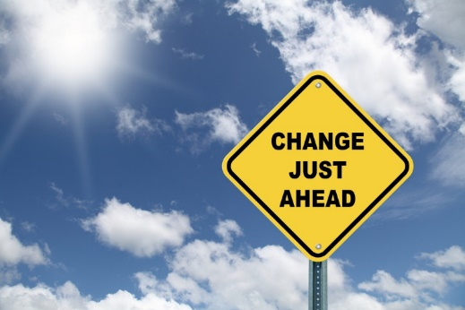
Transitions
In addition to being a problem nationwide, suicide is also a problem on our campus.
So much for the problem; what about the solution?
Now that you have seen what a serious problem illiteracy is, you may be asking yourself-“How can I help?”
Since we know a little more about what memory is, let us turn to the relationship between the human brain and the process of memory.
Notes:
Transitions are used to indicate movement from a completed thought to a new thought. Transitions indicate what idea is being left and what idea is coming up.

Slide 14

Internal Previews
We can help solve the problem by knowing how to identify the symptoms and knowing whom to contact for help.
Puzzles can be used for entertainment, as an indication of intelligence, and to help us develop better problem-solving techniques.
Notes:
Internal previews direct the audience to what areas will be covered next. Internal previews generally appear once the speaker has finished a transition and after a new main point. The speaker simply previews the subpoints which make up the point being addressed.

Slide 15

Internal Summaries
Therefore, anyone can help solve the problem by knowing how to identify the symptoms, and knowing whom to contact about helping them.
I hope I’ve made it clear that needed information is slipping right by us because the news doesn’t arouse our attention, it comes at us in unorganized segments, and the bits and pieces don’t allow the development of a schemata.
Notes:
Internal summaries are the flip side of internal previews. Rather than indicating what subpoints are to follow in the speech, internal summaries remind the listeners what subpoints have been discussed. Internal summaries are excellent ways to reinforce and clarify ideas which are essential for the audience to remember.

Slide 16

Signposts
Let’s first take a look at the nature of the problem.
The third warning sign is giving away one’s possessions.
And first, the most important thing to remember is child custody battle injure the children.
To begin with, we must examine the engine of the car.
Notes:
Signposts are short statements which tell the audience where the speaker is in the speech. Often, signposts are numbers of words which suggest that what the speaker is about to say is important. The following are examples of signposts.

Slide 17

Optional Resource How to explain anything to anyone: 4 steps to clearer communication
Article
https://ideas.ted.com/how-to-explain-anything-to-anyone-4-steps-to-clearer-communication/
Quantum Physics for 7 Year Olds
https://youtu.be/ARWBdfWpDyc

Slide 18
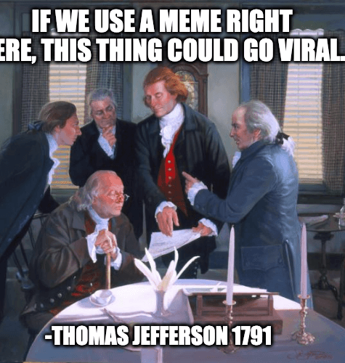
Strategies in creating a Science-based TED Talk
Five Talk Tools

Slide 19

Five Talk Tools for a TED Talk
Connection with the Audience
Narration (with a Point)
Explanation
Elaboration/Persuasion
Revelation

Slide 20
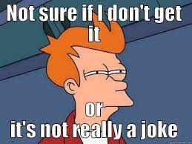
1) Connection: Get Personal
Personal Pronouns (I, We, You)
Use of humour
What are the potential benefits and pitfalls of using humour in a talk?
Anecdote
Tell a story that may resonate with the audience
Notes:
https://www.forbes.com/sites/steveolenski/2018/06/15/the-cmos-guide-to-using-humor-in-marketing/#21a3569762bf
Humour can be attention grabbing and makes the speaker relatable.
However humour may not be understood at best, and can be offensive at worse. It can also trivialize certain ideas.

Slide 21
1) Connection: Get Personal
Ask Questions to engage listeners in conversation
“So how many of you are making yourselves smaller through your body language?”
“If you use emoticons poorly in online negotiations, it’s a bad idea, right?”
“Can power posing for a few minutes really change your life in meaningful ways?
“So, I am watching this behaviour in the classroom, and what do I notice?”
Polling
Seeking Confirmation
Provoking Thought
Creating suspense

Slide 22
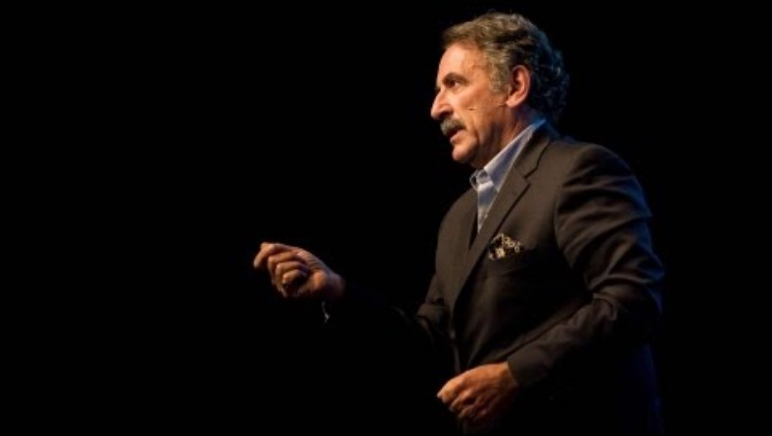
2) Narration: The Allure of Stories
Watch the first four minutes of the following talk. Consider why the story is effective.
Title: Want to help someone? Shut up and listen!
https://www.ted.com/talks/ernesto_sirolli_want_to_help_someone_shut_up_and_listen
Topic: Better approach to development aid in Africa
Speaker: Ernesto Sirolli, Sustainable Development Expert

Slide 23
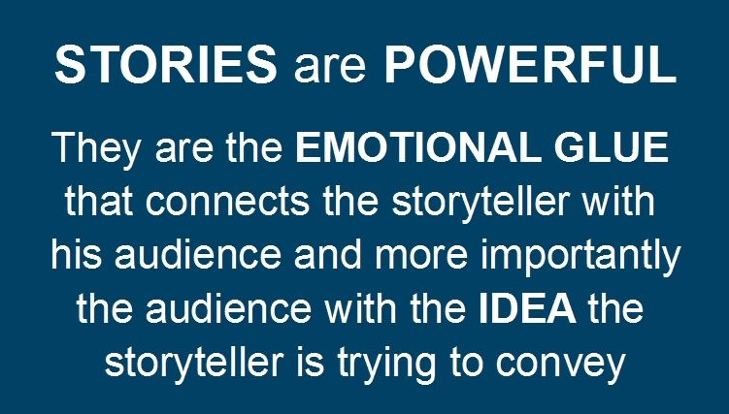
2) Narration: The Allure of Stories
Why the story is effective
Personal story of the speaker (his experience in NGO) draws connection to the audience
Authenticity through revelation of failures and vulnerability, and self-deprecation. (I was distraught; everything we touched, we killed; his naivety in Zambia)
Humour (everything we touched, we killed; his naivety in Zambia; the revelation of the hippo story; at least we fed the hipps )
Building of curiosity and ‘surprising’/funny ending (Why the project failed; Hippos ate the tomatoes)
Story offers insight that is relevant to the throughline (We should ask and listen to people in order to help them)
Right level of details and dialogue-rich story
Appropriate pace and stress on certain words

Slide 24
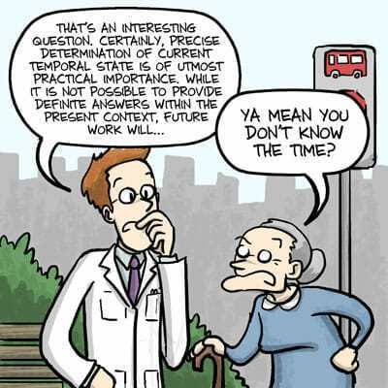
3) Explanation: How to Explain Tough Concepts
Recall first lesson
In written and oral science communication, be mindful of:
Jargon
Nominalisation
Subject-verb separation
Cohesive Device
Inappropriate stress position
Misplaced Topic Position
Placement of old and new information
Logical gaps

Slide 25
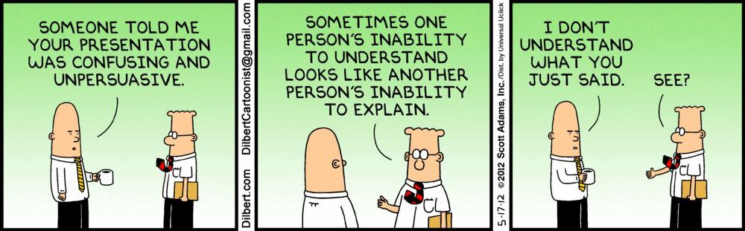
3) Explanation: How to Explain Tough Concepts
Curiosity and excitement
Systematic introduction of concepts
Vivid illustrations and examples
Precise sequencing of sentences and concepts

Slide 26
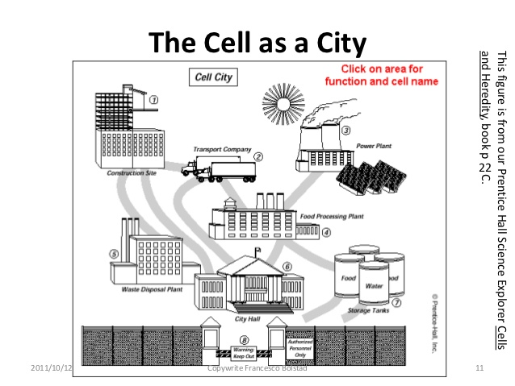
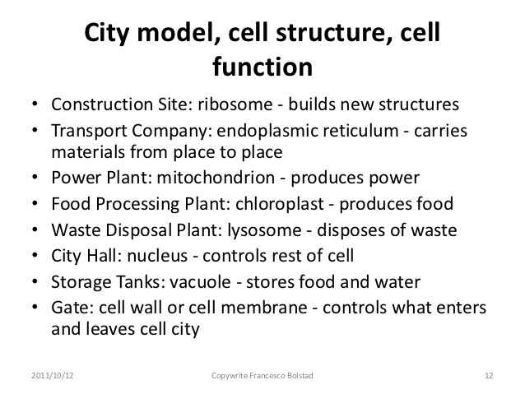
3) Explanation: How to Explain Tough Concepts
Metaphors/ Analogies should be complete, memorable and accessible

Slide 27
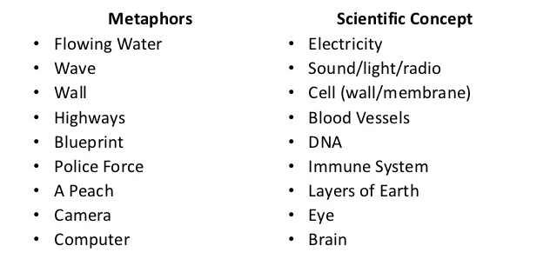
3) Explanation: How to Explain Tough Concepts
Metaphors and Analogies: Come up with a metaphor or an analogy for any chosen science concept.
Examples

Slide 28
3) Explanation: How to Explain Tough Concepts
Don’t describe data
Show the significance and impact of data in a way that a lay audience can appreciate
Show data’s relevance to the individual
Instead of presenting data of child mortality as:
“ Child mortality is at XX% in the world. In Sub-Saharan Africa, it is YY% and in high income countries, it stands at ZZ%”,
it may be more impactful to present:
“For every 1,000 children born, 39 will die before they turn five years old.
1 child in 36 dies in the first month” in poorer areas like Sub-Saharan Africa, while in the world’s high-income countries the ratio is 1 in 333.”

Slide 29
3) Explanation: How to Explain Tough Concepts
Compare the effectiveness in presenting the following diabetes data for lay audience.
a) “About 440,000 Singapore residents who were 18 years and above had diabetes in 2014, and the number is estimated to grow to 1,000,000 in 2050.”
OR
b) “Overall, one in nine Singaporeans have diabetes. But the prevalence increases as you age. If you are over 60, three in ten Singaporeans have diabetes. And since most Singaporeans will reach 60, that is a lot of us. In fact, if you look at yourself, and at the person sitting to your left, person sitting to your right, most probably at least one of you will have diabetes one day!”
(b) Depicts what the numbers actually mean, the implication of the number in Singapore context, and how significant the number is.

Slide 30
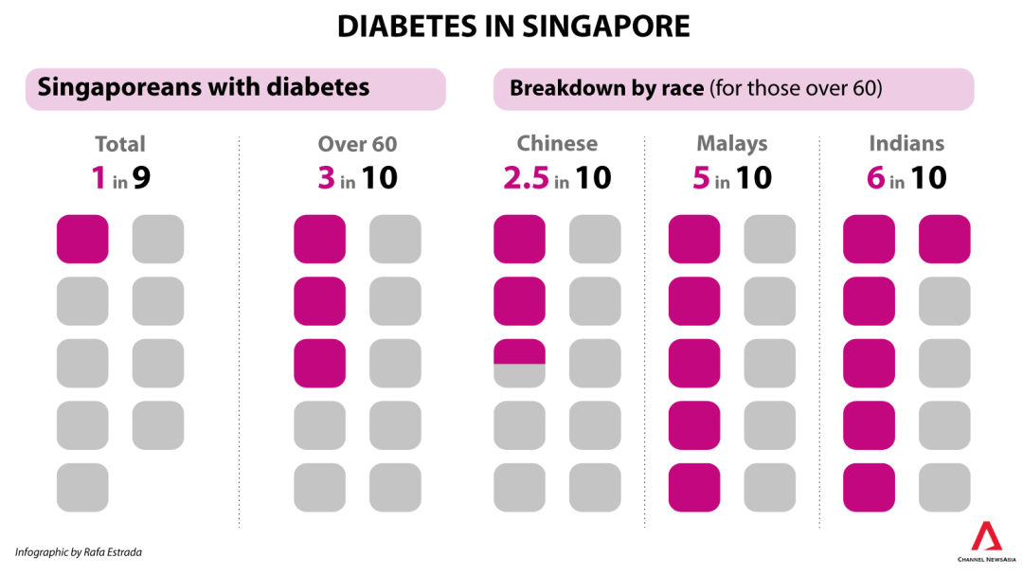
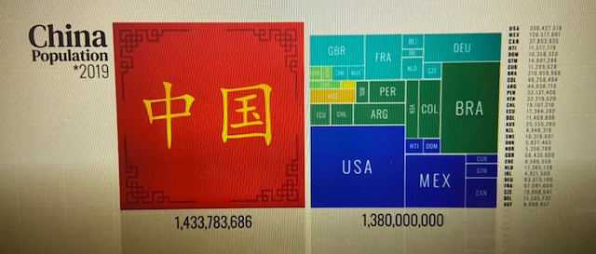
3) Explanation: How to Explain Tough Concepts
Data can be accompanied by clear and relevant graphics
China’s Population (adapted from The Rise of China, History 101, Netflix)

Slide 31
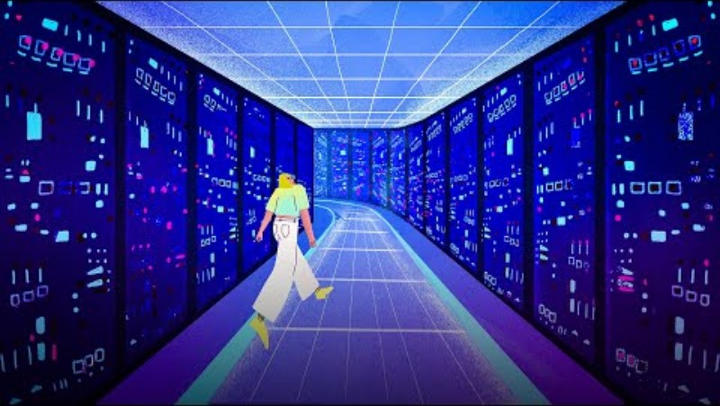
3) Explanation: How to Explain Tough Concepts
Watch the following talk. How does the talk exemplify good explanation?
Title: Hacking your memory -- with sleep (4 min 43 sec)
Topic: Neuroscience
Speaker: Matt Walker, Sleep Scientist

Slide 32
3) Explanation: How to Explain Tough Concepts
Watch the following talk. How does the talk exemplify good explanation?
Relate to audience’s lifestyle. Personal pronoun
Analogy: Information acquisition is akin to a sponge
Analogy: Computer system
Internal preview (how sleep…)
Signpost (The first..)
Explanation of how readers can think of ‘hippocampus’.
Signpost (The second..)
Analogy: Hippocampus as USB
Clear illustration of research
Illustration of learning in vivid way
Internal summary
Signpost (The final..)
Memorable/ Humorous closing
Notes:
Annotated version in the notes

Slide 33
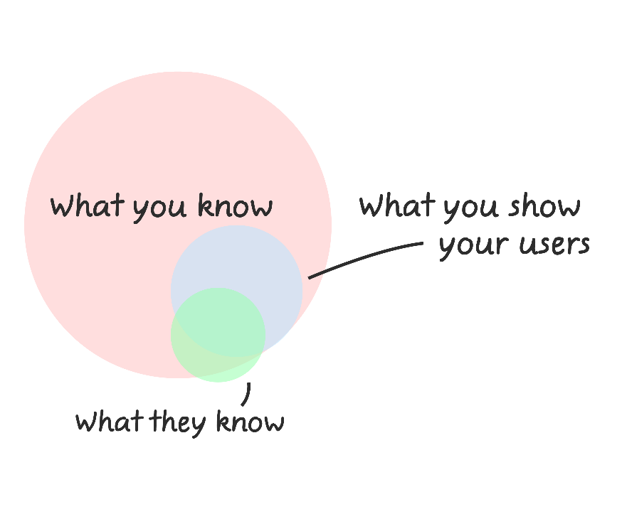
3) Explanation: How to Explain Tough Concepts
Avoid the curse of knowledge
A talk is not a container or a bin you put your content in; it is a process, a trajectory. The goal is to take the listener from where he is to someplace new. That means trying to make the sequence so stepwise that no one gets lost along the way. I rehearsed in front of friends and acquaintances who knew nothing about the topic, asking them where they were puzzled, hoping that by filling those gaps for them, I’d be filling the same gaps for other people.
– Dr. Deborah Gordon, Stanford University Biologist and TED Speaker
Notes:
https://medium.com/@roboticwrestler/the-curse-of-knowledge-in-presentations-a78bff3655af
https://medium.com/digital-vault/the-curse-of-knowledge-how-it-can-limit-even-the-best-marketers-ee08acb6c3d5

Slide 34
3) Explanation: How to Explain Tough Concepts
Avoid the curse of knowledge
Consider the following explanation. Why is it unclear?
Chimpanzees have vastly greater strength than humans. Humans learnt how to use tools to amplify their natural strength. Chimpanzees also use tools. They can amplify their strength.
The above can be replaced with this:
Although chimpanzees have vastly greater strength than humans, humans are much better tool user. And those tools have amplified human’s natural strength far beyond that of chimpanzees.

Slide 35
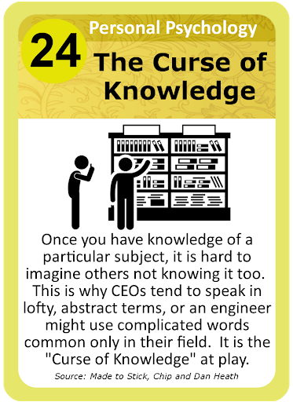
3) Explanation: How to Explain Tough Concepts
Avoid the curse of knowledge
For true understanding to take place, the full hierarchical structure of an idea must be communicated.
A speaker has to be sure that the listeners know how each sentence relates logically to the preceding one—is the relationship one of similarity, contrast, elaboration, exemplification, generalisation, before-and-after, cause or effect? (Refer to next lesson on connectives)
Recall first lesson on language for science communication (Cohesive Device, stress position, topic position, placement of old and new information and Logical gaps)

Slide 36
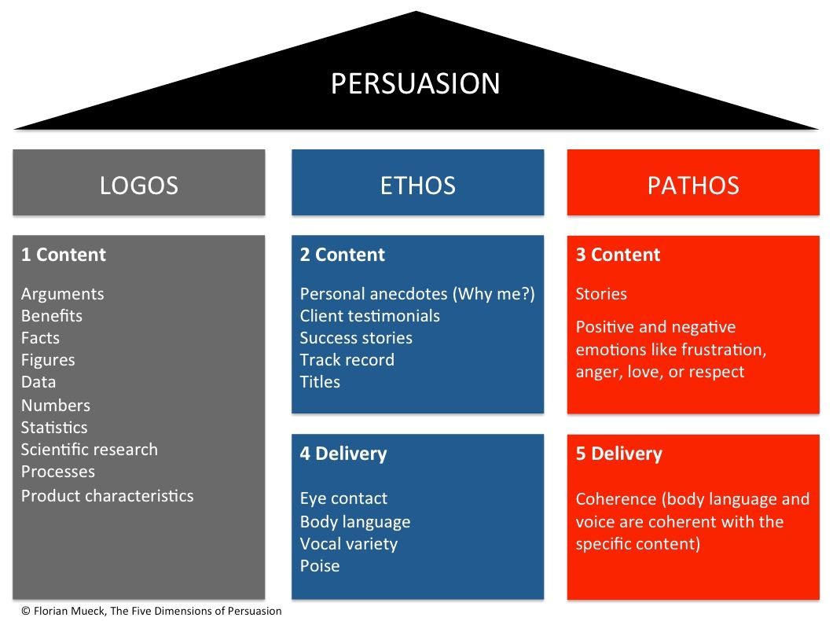
4) Persuasion: The Art & Science of Changing Minds

Slide 37
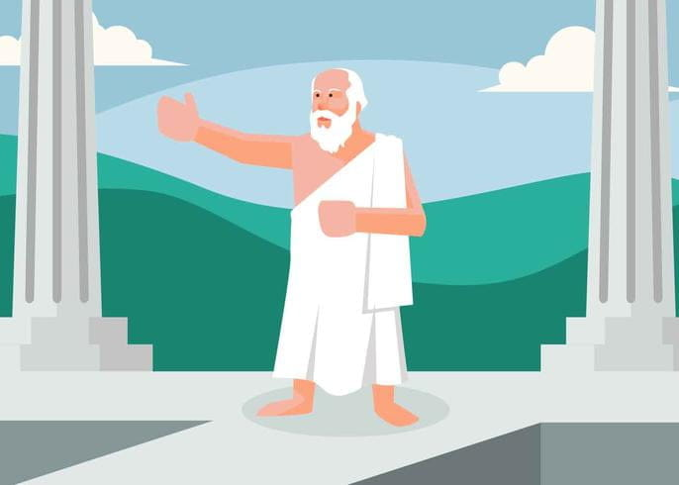
4) Persuasion: The Art & Science of Changing Minds
Priming
Breaking down Arguments
Refuting the counterarguments
The Detective Story

Slide 38
4) Persuasion: The Art & Science of Changing Minds
i) Priming
“There was a time when jeans came in one cut, and you bought them, and they fit like crap. They were incredibly uncomfortable, and if you wore them long enough and washed them enough times, they started to feel OK. I went to replace my jeans after years of wearing these old ones. I said, "I want a pair of jeans. Here's my size." And the shopkeeper said, "Do you want slim fit, easy fit, relaxed fit? You want button fly or zipper fly? You want stonewashed or acid-washed? Do you want them distressed? Do you want boot cut, tapered?" Blah, blah, blah on and on he went. My jaw dropped. And after I recovered, I said, "I want the kind that used to be the only kind."
Psychologist Barry Schwartz’s talk on how too much choices make us unhappy
Even though it may be a specific experience of just the speaker, the story influences near-term future thoughts and actions, as we recall times in which we were paralysed by choices when shopping.
In effect, priming either introduces new things or brings old thoughts close to the surface of the subconscious

Slide 39
4) Persuasion: The Art & Science of Changing Minds
iv) The Detective Story
Relevant for Science talks
https://www.ted.com/talks/siegfried_woldhek_the_search_for_the_true_face_of_leonardo?language=en
Undergoing the same learning journey as the speaker.
Instead of being told the facts, we join the process of discovery.
As we eliminate rival theories one by one, we gradually become convinced—we persuade ourselves.
Notes:
Artist Siegfried wanted to prove that three famous Leonardo da Vinci drawings were actually self-portraits from different stages of his life. To make the case, he framed the talk as his quest to discover the “true face” of Leonardo da Vinci. He started with a full palette of the 120 male portraits that Leonardo is credited with and asked: Were any if these self-portraits? How could we know? And then, like a detective eliminating suspects, he started cutting them down, using his skills as a portrait painter, until only three remained.
What makes this persuasive is that we feel as if we have gone on the same learning journey as the speaker. Instead of being old the facts, we have been invited to join the process of discovery. As we eliminate rival theories one by one, we gradually become convinced—we persuade ourselves.

Slide 40

4) Persuasion: The Art & Science of Changing Minds
Other than logos, other strategies of persuasion are:
Injecting humour (Pathos)
Telling stories that appeal to emotions (Pathos)
Adding personal anecdote (Ethos)
Recruiting third-party validation (Ethos)
Offering vivid examples (Logos)
Using powerful visuals (Logos and Pathos)

Slide 41

5) Revelation
Present a series of images and talk through them
Give a demonstration of a product or experiment, accompanied by the explanation of how it works
Paint a bold picture of the alternative future you desire and do so in a way that inspires listeners

Slide 42
5) Revelation
Example 1: How to make filthy water drinkable by Michael Pritchard
https://www.ted.com/talks/michael_pritchard_how_to_make_filthy_water_drinkable?language=en
Example 2: A robot that flies like a bird by Markus Fischer
https://www.ted.com/talks/markus_fischer_a_robot_that_flies_like_a_bird?language=en
Structure used for demonstrations
An initial tease
Necessary background, context, or invention story
The demonstration itself
The implications of the technology

Slide 43
Homework
Confirmation of TED Talk topic, throughline and title by 12 July (Friday).
Read page 22—29 of the notes

Slide 44
Strategies in creating a TED Talk

Slide 45
01 Connectives
02 Opening & Closing
03 Language & Rhetorical Devices
05 Delivery
04 Visuals & Slides
Contents

Slide 46
Opening the Talk
Types of Hook
Story/personal anecdote
Question(s)
Shocking statement
Imagine a scenario
Ignite Curiosity
Read the opening paragraphs on page 22—23. What is the strategy used in the hook?
What are the other elements used in these opening paragraphs?
Notes:
Refer to pages 26-27 (teacher’s copy)

Slide 47
Opening the Talk
Show a compelling slide, video, or object
“The image you’re about to see changed my life.”
“I’m going to play you a video that, at first viewing, may seem to be impossible.”
“Here’s my opening slide. Can you figure out what this thing is?”
“Until two and a half months ago, no living human had cast eyes on this object.”
Works well for talks on technology and invention, as well as conceptual talks

Slide 48
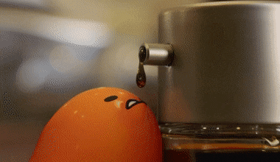
Opening the Talk
Show a compelling slide, video, or object
“First, a video. Yes, it is a scrambled egg. But as you look at it, I hope you'll begin to feel just slightly uneasy. Because you may notice that what's actually happening is that the egg is unscrambling itself. And you'll now see the yolk and the white have separated. And now they're going to be poured back into the egg. And we all know in our heart of hearts that this is not the way the universe works. A scrambled egg is mush -- tasty mush -- but it's mush. An egg is a beautiful, sophisticated thing that can create even more sophisticated things, such as chickens. And we know in our heart of hearts that the universe does not travel from mush to complexity. In fact, this gut instinct is reflected in one of the most fundamental laws of physics, the second law of thermodynamics, or the law of entropy. What that says basically is that the general tendency of the universe is to move from order and structure to lack of order, lack of structure -- in fact, to mush. And that's why that video feels a bit strange.”
- The History of our world in 18 minutes, David Christian
Notes:
https://www.ted.com/talks/david_christian_the_history_of_our_world_in_18_minutes#t-24265

Slide 49
Opening the Talk
State how the topic is important, relevant or beneficial for them to know about
For all that's ever been said about climate change, we haven't heard nearly enough about the psychological impacts of living in a warming world. If you've heard the grim climate research that science communicators like me weave into our books and documentaries, you've probably felt bouts of fear, fatalism or hopelessness. If you've been impacted by climate disaster, these feelings can set in much deeper, leading to shock, trauma, strained relationships, substance abuse and the loss of personal identity and control. Vital political and technological work is underway to moderate our climate chaos, but I'm here to evoke a feeling in you for why we also need our actions and policies to reflect an understanding of how our changing environments threaten our mental, social and spiritual well-being.
- How climate change affects your mental health, Britt Wray

Slide 50
Opening the Talk
Guide your audience by making your throughline clear and giving them a sense of how your talk is structured / Preview of the talk
On the path that American children travel to adulthood, two institutions oversee the journey. The first is the one we hear a lot about: college. College has some shortcomings. It’s expensive; it leaves young people in debt. But all in all, it’s a pretty good path. Today I want to talk about the second institution overseeing the journey from childhood to adulthood in the United States. And that institution is prison. Young people on this journey are meeting with probation officers instead of with teachers. They're going to court dates instead of to class. And they're emerging from their 20s not with degrees in business and English, but with criminal records. There are more and more kids on this journey to adulthood than ever before in the United States and that's because in the past 40 years, our incarceration rate has grown by 700 percent.
- How we are priming some kids for college—and others for prison, Alice Goffman

Slide 51
How not to end:
“Well, that’s my time gone, so I’ll wrap up there.” (Insinuates bad planning)
“The future is full of challenges and opportunities. Everyone here has it in their heart to make a difference. Let’s dream together. Let’s be the change we want to see in the world.” (Cliché)
“I’m sorry I haven’t had time to discuss some of the major issues here, but hopefully this has at least given you a flavour of the topic.” (Does not inspire confidence)
“Thanks for being such an amazing audience. I have loved every moment, standing here, talking to you. I’ll carry this experience with me for a long, long time. You’ve been so patient…(Gushing and draggy)
“So that concludes my argument, now are there any questions?” (Generic and not ending with impact)

Slide 52
i) Camera Pull-back
Provide a bigger picture and a broader set of possibilities implied by your sharing.
“Just imagine an astronaut being able to feel the overall health of the International Space Station, or, for that matter, having you feel the invisible states of your own health, like your blood sugar and the state of your microbiome, or having 360-degree vision or seeing in infrared or ultraviolet. So the key is this: As we move into the future, we’re going to increasingly be able to choose our own peripheral devices. We no longer have to wait for Mother Nature’s sensory gifts on her timescales, but instead, like any good parent, she’s given us the tools that we need to go out and define our own trajectory. So the question now is, how do you want to go out and experience your universe?”
Notes:
A thought-provoking or an engaging question is a good way to end.

Slide 53
ii) Call to Action iv) Values and Vision
“The great thing about social media was how it gave a voice to voiceless people, but we’re now creating a surveillance society, where the smartest way to survive is to go back to being voiceless. Let’s not do that.”
“Teaching and learning should bring joy. How powerful would our world be if we had kids who were not afraid to take risks, who were not afraid to think, and who had a champion? Every child deserves a champion, an adult who will never give up on them, who understands the power of connection, and insists that they become the best that they can possibly be. Thank you so much.” Is this job tough? You bet. But it is not impossible. We can do this. We’re educators. We’re born to make a difference.
Suitable for topics that require action or response where the speaker urges or inspires listeners to act
Notes:
A thought-provoking or an engaging question is a good way to end.

Slide 54
Other Strategies for Closing
iii) Personal commitment
v) Satisfying encapsulation
vi) Narrative symmetry

Slide 55
Language Enhancement & Rhetorical Devices

Slide 56
i) Alliteration, Assonance and Consonance
Alliteration: Repetition of initial consonant letters (or sounds) in two or more different words across successive sentences, clauses, or phrases
Assonance: Repetition of vowel sounds
Consonance: Repetition of consonant sounds
"This generation of soldiers, sailors, airmen, Marines, and Coast Guardsmen have volunteered in the time of certain danger. They are part of the finest fighting force that the world has ever known. They have served tour after tour of duty in distant, different, and difficult places.
-Barack Obama, Fort Hood Memorial Service Speech

Slide 57
ii) Anaphora, Epistrophe and Symploce
Anaphora: Repetition of the same word/words at the beginning of successive phrases or sentences.
Epistrophe: Applied to the ends of phrases or sentences.
Symploce: Combines the two.
"...that this nation, under God, shall have a new birth of freedom; and that government of the people, by the people, for the people shall not perish from the earth."
- Abraham Lincoln, Gettysburg Address
"While we have faced challenges before, this one [COVID-19] is different. This time we join with all nations across the globe in a common endeavor, using the great advances of science and our instinctive compassion to heal. We will succeed, and that success will belong to every one of us. We should take comfort that while we may have more still to endure, better days will return: we will be with our friends again; we will be with our families again; we will meet again."
-Queen Elizabeth II, Palm Sunday Address on the Novel Coronavirus

Slide 58
iii) Anadiplosis
Repetition that occurs when the last word or terms in one sentence, clause, or phrase is/are repeated at or very near the beginning of the next sentence, clause, or phrase.
"Once you change your philosophy, you change your thought pattern. Once you change your thought pattern, you change your attitude. Once you change your attitude, it changes your behavior pattern and then you go on into some action."
-Malcolm X, The Ballot or the Bullet

Slide 59
iv) Rule of three and Hendiatris
Three elements provide brevity and rhythm with the smallest amount of information needed to create a pattern.
Hendiatris: Use of three words or phrases in succession to express a single concept.
Abraham Lincoln’s Gettysburg Address:
“We cannot dedicate — we cannot consecrate — we cannot hallow — this ground.“
“Government of the people, by the people, for the people“
General MacArthur, West Point Address, 1962:
“Duty, Honor, Country. Those three hallowed words reverently dictate what you ought to be, what you can be, and what you will be.”

Slide 60
Effective Visuals

Slide 61
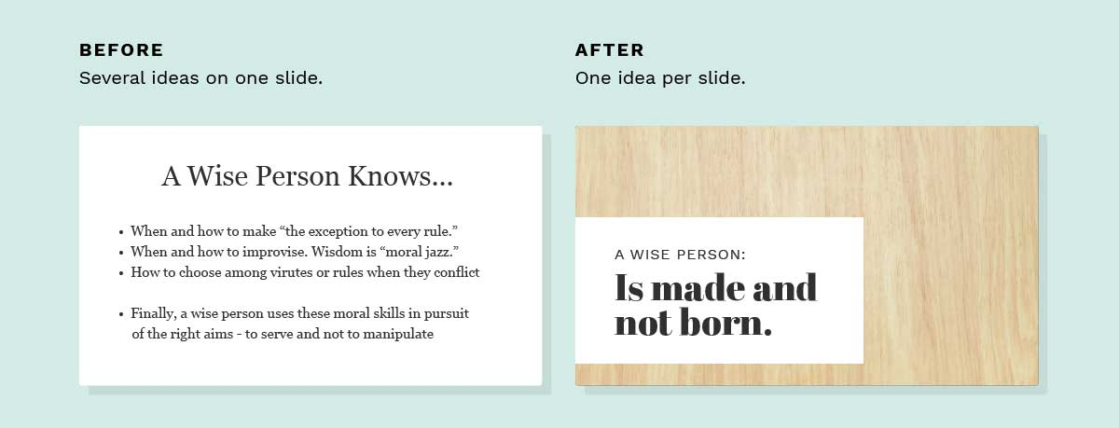
Limit each slide to a single core idea
Notes:
Another Example:
Instead of a slide that reads: A black hole is an object so massive that no light can escape from it, you may do better with one that reads: How black is a black hole? Then you give information from that original slide in spoken form. That way, the slide teases the audience’s curiosity and makes your words more interesting.

Slide 62

Do not simply repeat in text what you are going to present verbally.
With a talk and slides, you have two streams of cognitive output running in parallel. The speaker needs to blend both streams into a master mix. Talking about theoretical physics has a high cognitive load. So does a slide with dozens of elements. In these circumstances, the audience member’s brain has to decide whether to focus on your words, your slides, or both, and it’s mostly involuntary. So you should make sure that a cognitive load on a slide does not fight with what you are saying.
- Tom Rielly, TED Speaker
Notes:
There is no value in simply repeating in text what you are going to present verbally. Conceivably, if you are developing a point over a few minutes, it may be worth having a word or phrase to remind people of the topic at hand. But otherwise, words on the screen may be fighting your oral delivery, instead of enhancing it.
Instead of a slide that reads: A black hole is an object so massive that no light can escape from it, you may do better with one that reads: How black is a black hole? Then you give information from that original slide in spoken form. That way, the slide teases the audience’s curiosity and makes your words more interesting.

Slide 63
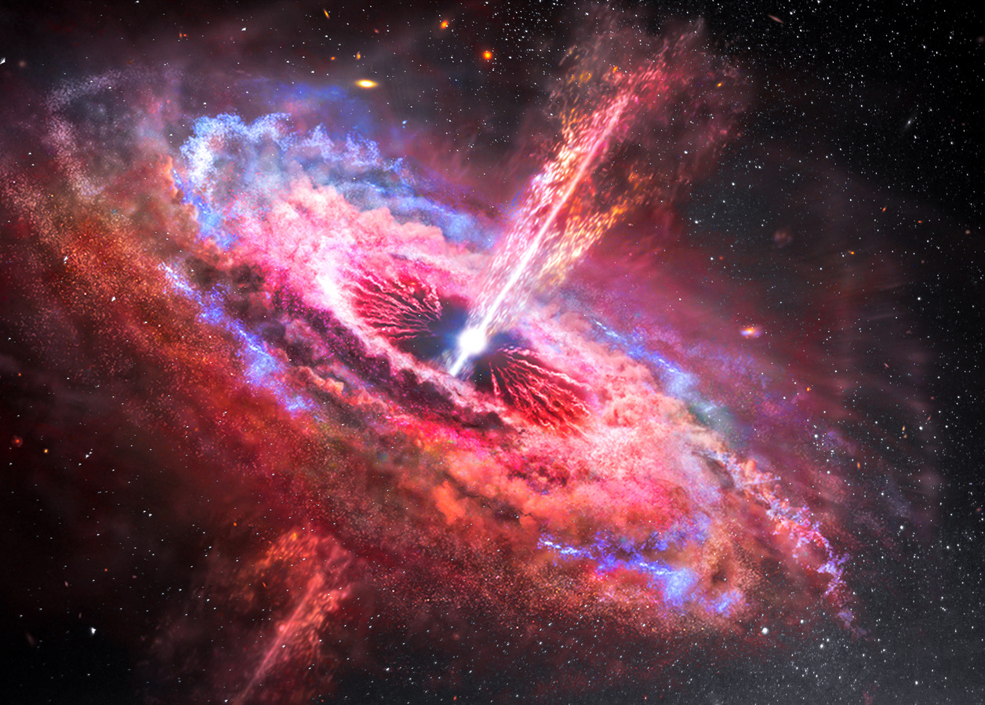
Provoke Curiosity
Topic: Black hole
Which set of accompanying text (for the picture) incites curiosity and is more interesting?
A black hole is a region of spacetime where gravity is so strong that nothing—no particles or even electromagnetic radiation such as light—can escape from it. The theory of general relativity predicts that a sufficiently compact mass can deform spacetime to form a black hole.
VS
How black is a black hole?
Notes:
Instead of a slide that reads: A black hole is an object so massive that no light can escape from it, you may do better with one that reads: How black is a black hole? Then you give information from that original slide in spoken form. That way, the slide teases the audience’s curiosity and makes your words more interesting.

Slide 64
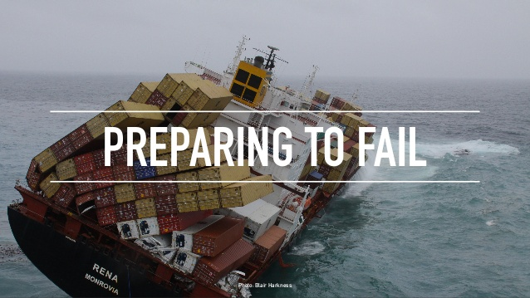
Appropriate Visuals /Visuals that enhance meaning
Example of visual that is relevant and punchy (metaphor)
Notes:
Using simple, punchy photos in presentations help in resonating with the audience without pulling their attention from your spoken words. Look for photos that (1) speak strongly to the concept you are talking about and (2) aren’t compositionally complex. Your photo could be a metaphor or something more literal, but it should be clear why the audience is looking at it, and why it’s paired with what you’re saying.
https://www.inc.com/anna-guerrero/10-ted-talks-that-used-visual-graphics-to-win-the-audience.html

Slide 65
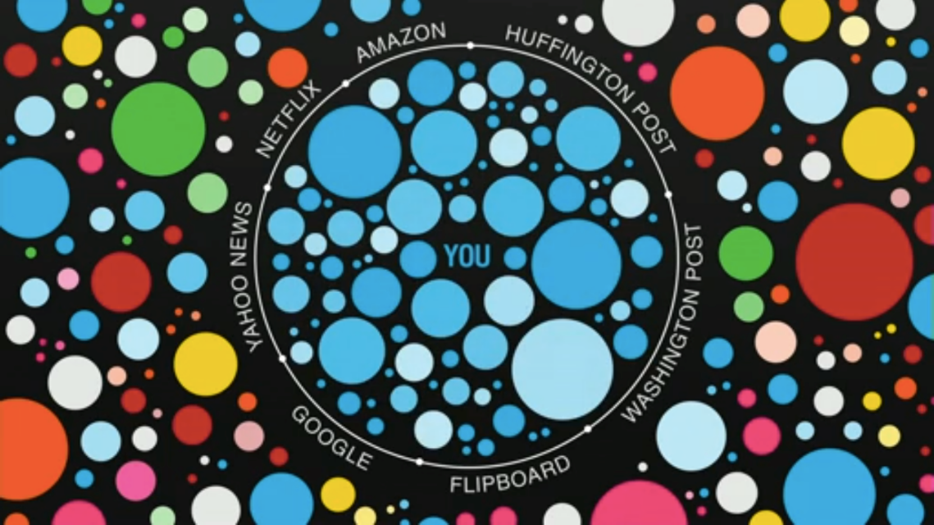
Appropriate Visuals /Visuals that enhance meaning
‘Filter bubbles’ in the media, and its negative impact
Notes:
Talk:
https://www.ted.com/talks/eli_pariser_beware_online_filter_bubbles/transcript?language=en
Be sure you are not regurgitating information you are speaking onto your slides, or vice versa. Your slides should be a complement to what you are saying, a visual representation to enhance the understanding of your content, not a mirror image of your speech.
https://www.inc.com/anna-guerrero/10-ted-talks-that-used-visual-graphics-to-win-the-audience.html

Slide 66
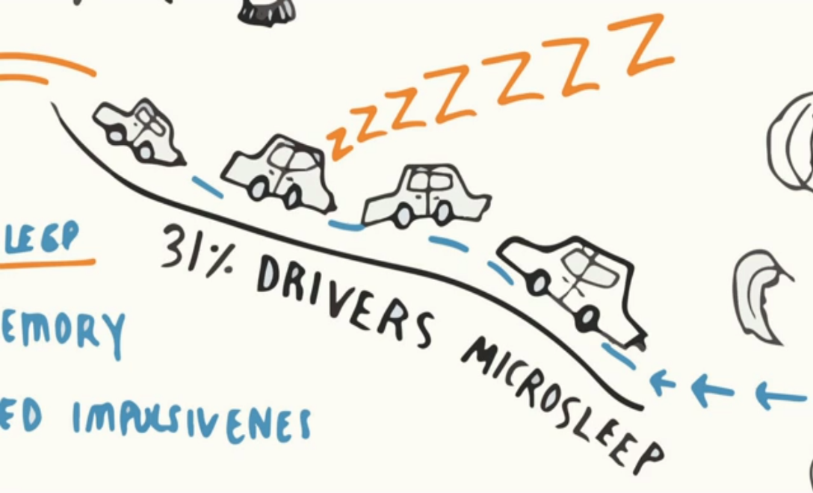
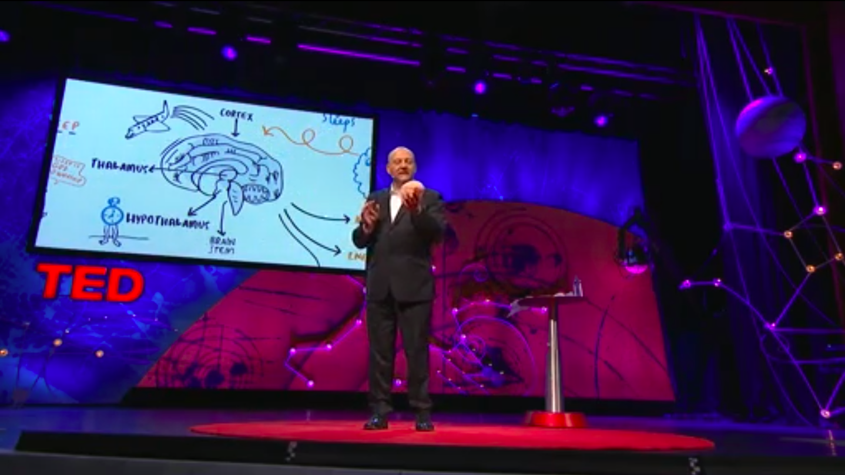
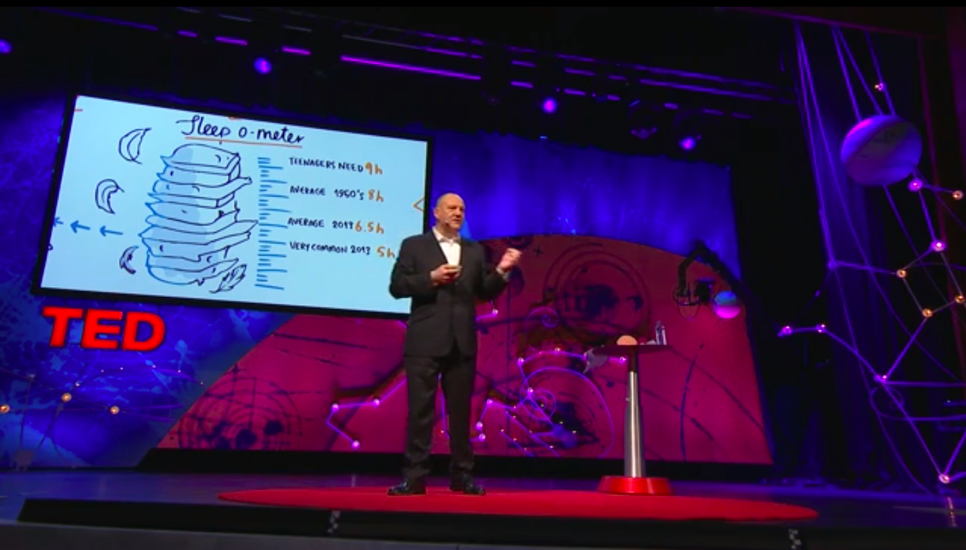
Appropriate Visuals /Visuals that enhance meaning
Examples of visuals from talk on why we sleep
Notes:
Talk:
https://www.ted.com/talks/russell_foster_why_do_we_sleep?referrer=playlist-surprisingly_viral_ted_talks
Each illustration is not complements his spoken words, but also acts as a data visualization for statistics or important details to better explain the complex points of information in more understandable, accessible ways. Throughout his talk, on top of the detailed illustrations, Foster utilises props to even further immerse viewers and explain his points. Utilize visuals in whatever way you see fit to enhance your viewers understanding of your content.

Slide 67
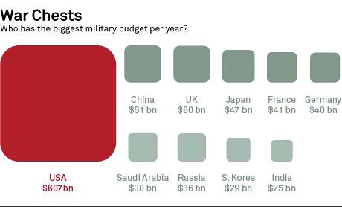
Present Data Visually
Example 1: Refer to notes on page 30—31 on military budget
Example 2: Watch the Best Stats you have ever seen by Hans Rosling (4.05—5.00) https://www.ted.com/talks/hans_rosling_the_best_stats_you_ve_ever_seen?language=en#t-232763
Notes:
Consider whether anything more can be with a slide to highlight the point it is trying to make.
This is especially true with graphs and charts. For example, if your point is that the rainfall in February is always greater than in October, and you show a graph of annual rainfall, you can highlight October and February in different colours.

Slide 68
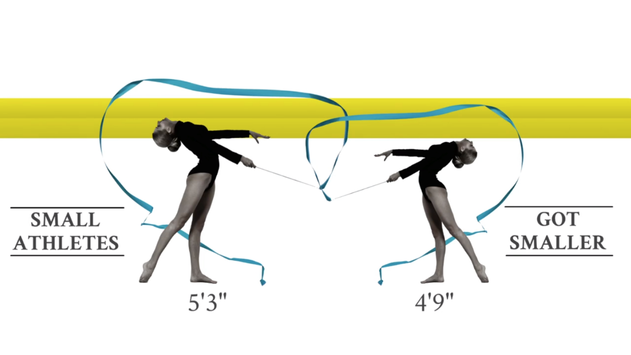
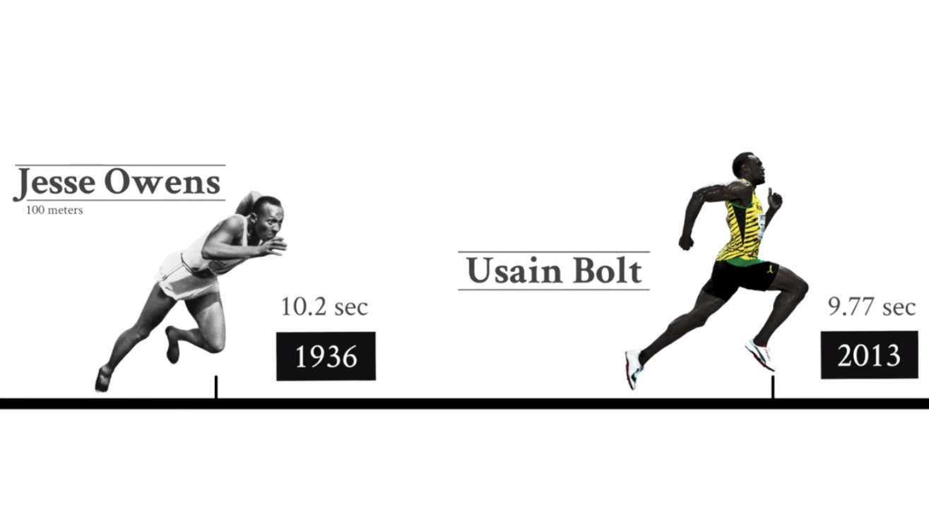
Present Data Visually
‘Are athletes really getting faster, better, stronger?’
Notes:
https://www.ted.com/talks/david_epstein_are_athletes_really_getting_faster_better_stronger
This presentation by David Epstein delivers some impressive facts and numbers through striking data visualizations. By combining powerful athletic imagery, a striking use of color, and a consistent design theme, he creates a visually beautiful and captivating presentation. By using black and white masked imagery, occasional pops of color, powerful photographs and combining them together to create data visualization, he turns simple facts into striking pieces of information. Notice as well how Epstein uses color to draw the eye to certain elements of each slide, in this case, the neon green/yellow color is used to highlight important elements. Be intentional with your use of color and let it guide your viewers' eyes.

Slide 69
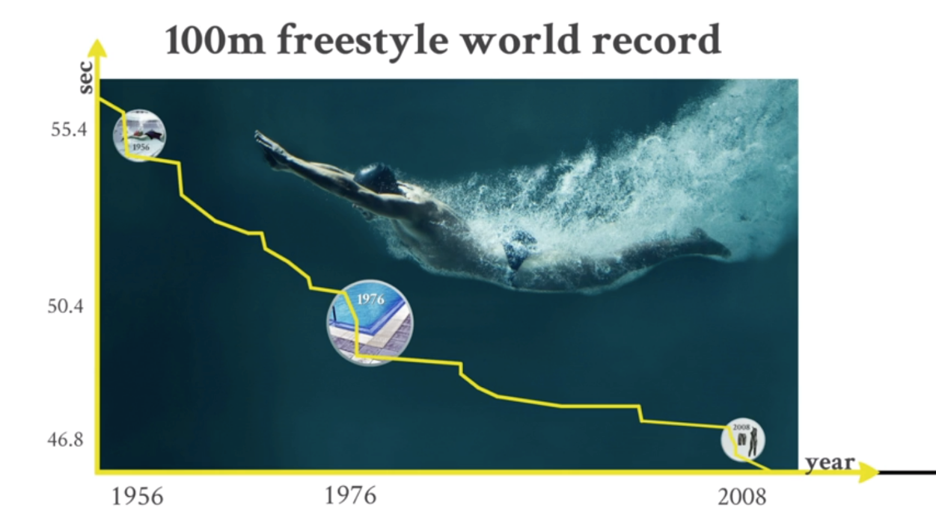
Present Data Visually
‘Are athletes really getting faster, better, stronger?’
Notes:
https://www.ted.com/talks/david_epstein_are_athletes_really_getting_faster_better_stronger
This presentation by David Epstein delivers some impressive facts and numbers through striking data visualizations. By combining powerful athletic imagery, a striking use of color, and a consistent design theme, he creates a visually beautiful and captivating presentation. By using black and white masked imagery, occasional pops of color, powerful photographs and combining them together to create data visualization, he turns simple facts into striking pieces of information. Notice as well how Epstein uses color to draw the eye to certain elements of each slide, in this case, the neon green/yellow color is used to highlight important elements. Be intentional with your use of color and let it guide your viewers' eyes.

Slide 70
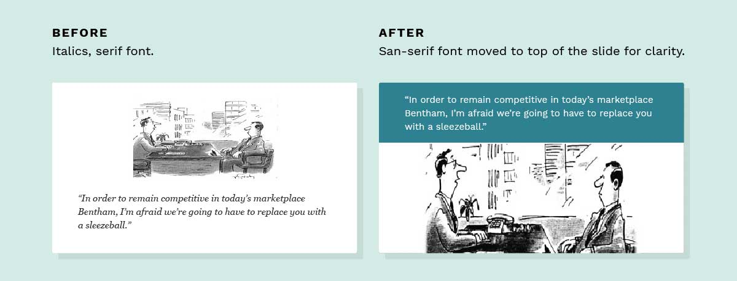
Font Type, Size & Colour
What is an appropriate font type? How many types of font should you use within a slide?
What is an appropriate font size? How many sizes should you use within a slide?
What are the Dos and Don’ts of font colours and background?
Should you use effects, animations and transitions?
Picture courtesy of Doug Neff
Notes:
Font: One typeface per presentation
Recommendation: Medium-weight sans-serif fonts like Helvetica or Arial.
Do not use excessively thin fonts
Use 24 points or larger
Use at most three sizes of your chosen typeface per presentation: large size for titles; medium size for main ideas; small size for supporting ideas.
Font colour should contrast the background.
Avoid using bullet points, underlining or italicising as they may be hard to read.
Credit photos on each slide, but use small fonts in order not to distract. If all images are from one source, you can add one photo credit: “Photographs courtesy of National Geographic”.
Go easy on the effects and transitions. Most of these don’t do much to enhance the audience experience. At worst, they subtly suggest that the content of your slides is so uninteresting that a page flip or droplet transition will snap the audience out of their lethargy. If you must use them, use the most subtle ones, and keep it consistent.
Use masking to direct attention in images. If you want to point something out in a photo, you could use a big arrow, or you could ‘dupe-and-mask’.

Slide 71
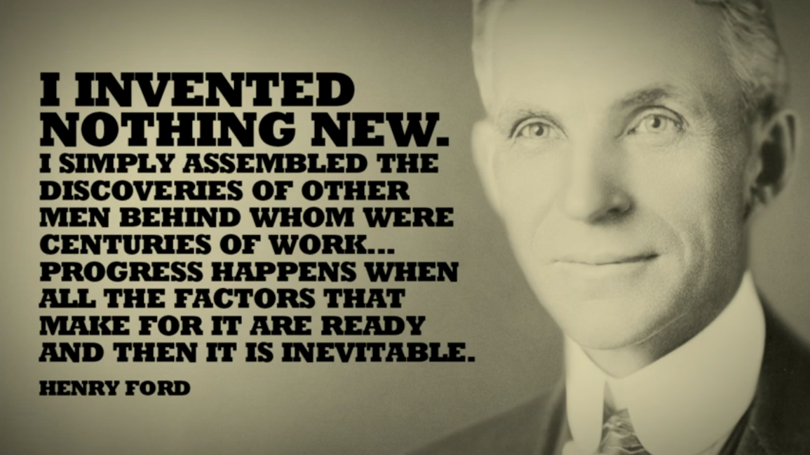
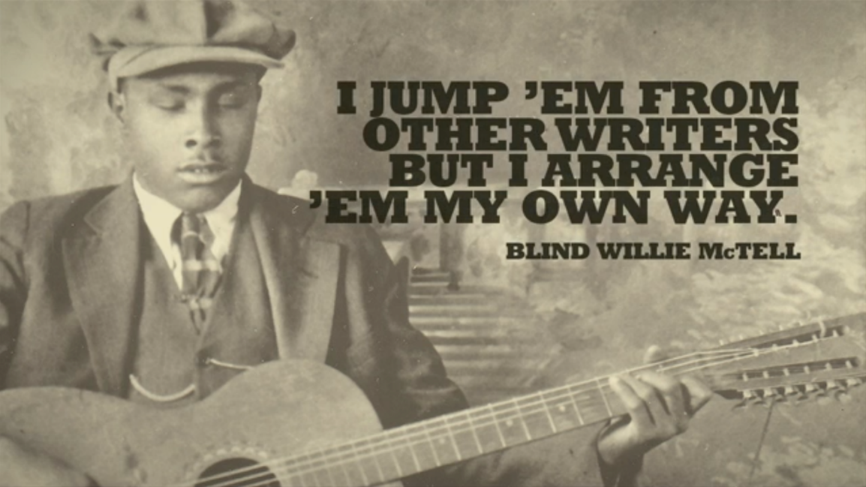
Consistent Slide Design
Resource for Presentation Template:
https://www.canva.com/templates/search/presentations
Notes:
Font: One typeface per presentation
Recommendation: Medium-weight sans-serif fonts like Helvetica or Arial.
Do not use excessively thin fonts
Use 24 points or larger
Use at most three sizes of your chosen typeface per presentation: large size for titles; medium size for main ideas; small size for supporting ideas.
Font colour should contrast the background.
Avoid using bullet points, underlining or italicising as they may be hard to read.
Credit photos on each slide, but use small fonts in order not to distract. If all images are from one source, you can add one photo credit: “Photographs courtesy of National Geographic”.
Go easy on the effects and transitions. Most of these don’t do much to enhance the audience experience. At worst, they subtly suggest that the content of your slides is so uninteresting that a page flip or droplet transition will snap the audience out of their lethargy. If you must use them, use the most subtle ones, and keep it consistent.
Use masking to direct attention in images. If you want to point something out in a photo, you could use a big arrow, or you could ‘dupe-and-mask’.

Slide 72
Verbal & Non-verbal Delivery

Slide 73
Speak with Meaning
Prosodic features (intonation, stress and rhythm) enhance the meaning of the speech.
Listen to the opening minute of the TED Talk by George Monbiot and pay attention to the prosody features. Mark out the intonation, stress and rhythm.
https://www.ted.com/talks/george_monbiot_for_more_wonder_rewild_the_world?language=en
Notes:
Other than pronunciation and articulation, successful communication depends as much on intonation, stress and rhythm. These are known as prosodic features: how sounds are put together in connected speech. Prosody helps to differentiate questions from sentences, to recognise a speaker’s emotional state and to clarify communication. In short, prosodic features (intonation, stress and rhythm) enhance the meaning of the speech.

Slide 74
Power of the Pause
To add dramatic effect and build connection with the audience when accompanied with eye contact (Dramatic pause)
To allow the audience time to process the information (Comprehension pause)
To allow audience to process the jokes/quip (Humorous pause)
To signal transition to the next point/slide (Transitional pause)
Notes:
Other than pronunciation and articulation, successful communication depends as much on intonation, stress and rhythm. These are known as prosodic features: how sounds are put together in connected speech. Prosody helps to differentiate questions from sentences, to recognise a speaker’s emotional state and to clarify communication. In short, prosodic features (intonation, stress and rhythm) enhance the meaning of the speech.

Slide 75
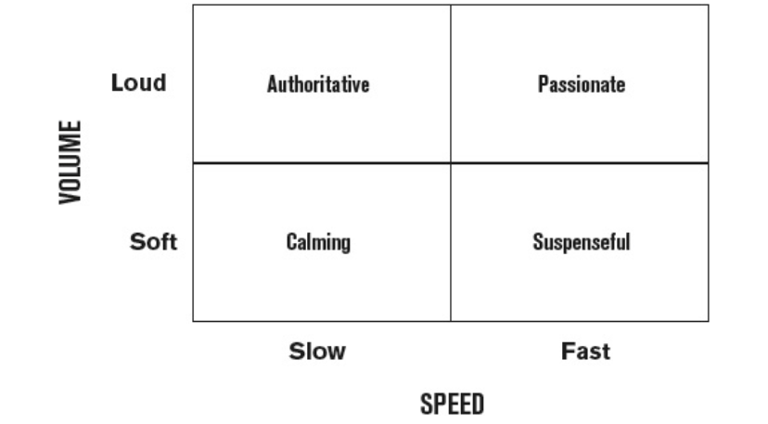
Vary Speed & Volume
Natural, conversational pace: 130–170 words per minute.
Notes:
While TED talks require speakers to spend much time in the passionate quadrant, the key to holding audience interest is to use contrast by varying the use of the four quadrants above. For example, during anecdotes and lighter moments, speed up. But when you are introducing key ideas or explaining something that is complex, slow down and insert pauses (authoritative).

Slide 76
Tone of a passionate conversationalist
Oration VS Conversationalist
Listen to the commencement speech by Steve Jobs. Consider the ways he exemplified the passionate conversationalist.
https://www.ted.com/talks/steve_jobs_how_to_live_before_you_die
https://www.youtube.com/watch?v=wHGqp8lz36c
Notes:
To address a crowd of any size, it is advised by some that speakers would have to slow down, with dramatic pauses after each sentence. It is a style of speaking we recognise today as oration. We associate it with some of the most influential speeches in literature and history, from Martin Luther King’s “I have a dream” to Patrick Henry’s “Give me liberty, or give me death!”
But in most modern settings, oration is best used sparingly. Instead, adopt the tone of a passionate conversationalist who speaks intimately and authentically to a crowd. Such tone may build connection and curiosity more easily than oration.

